Slide 1
Accessing self-service
A Brief how to

Slide 2
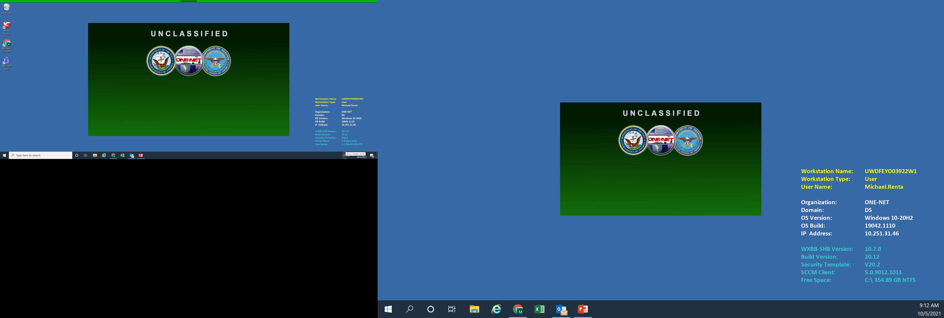
Step one
Locate small arrow on the lower right side of your screen and click to show hidden icons.

Slide 3
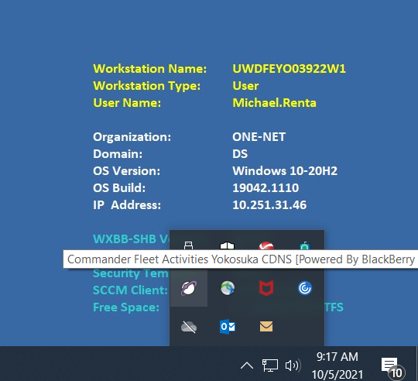
Step two
Click the white and purple icon shaped like Saturn, then click access self-service, authenticate common access card and enter pin.

Slide 4
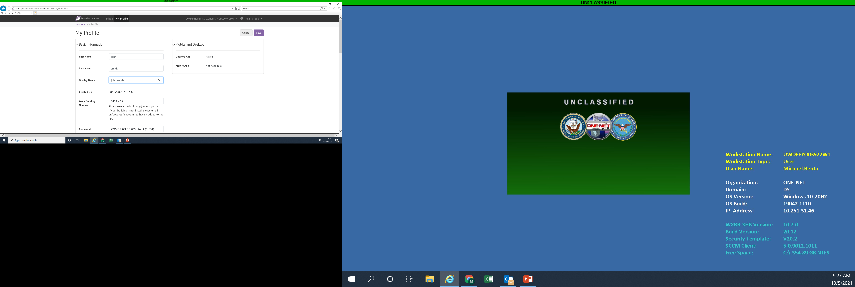
Step three
Fill in all personal information. This information is only used to contact and inform you on any emergency/ natural disaster.
When completed click save on the top right of the page and you are set.

